Slide 1

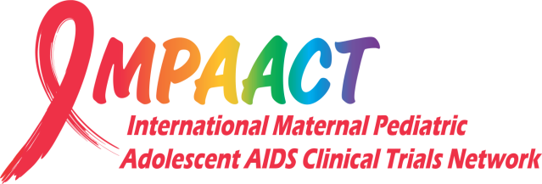
ART in pregnancy
Pregnant Woman by Cuth
Lynda Stranix-Chibanda
Notes:
Thank you to the conference organisers for the invitation to speak today.

Slide 2
I have no conflict of interest to declare
Disclosures
Notes:
I have no conflict of interest to declare, but I do have a question for the clinicians in the room [KEY}

Slide 3
Have you ever treated a client whose story touched you so deeply that it stayed with you throughout your career?
Notes:
Have you ever treated a client whose story touched you so deeply that it stayed with you throughout your career? Well, I was fortunate to meet an extraordinary woman who we’ll call ‘Shamiso’ at the beginning of my Paediatric career about 20 years ago [KEY]

Slide 4
In memory of ‘Shamiso’
Pregnant Woman by Cuth
Notes:
And I deliver this talk in her memory. Shamiso was a woman living in Zimbabwe who was diagnosed with HIV when she registered for antenatal care at the local clinic. I met her when she came for her monthly check-up with her beautiful chubby baby with cheeks like [THIS] who was breastfeeding vigourously. Shamiso had a CD4 count of 5 and I had no treatment to offer her. We had no access to ART in those days for treatment, or for treatment as prevention. No viral load monitoring or early infant diagnostic tests. We had cotrimoxazole and short course zidovudine for prophylaxis along with advice, about health living and how to feed her baby. Shamiso probably knew an awful lot more about that than this naïve clinician. Shamiso faced stigma, partner violence, health related anxiety. Sadly, she got sick with TB and demised. I tell you her story because Shamiso reminds me of how different things are today – having access to ART has changed so much for women with HIV, has revolutionised our paediatric in-patient wards. But, many things remain the same and the current system still fails to meet all of their needs. I thank Shamiso for all she taught me, and all the clients and study participants who generously share their time and experiences to help us learn about how to address those needs. To begin with a few figures to illustrate how many people we’re talking about. [KEY]

Slide 5
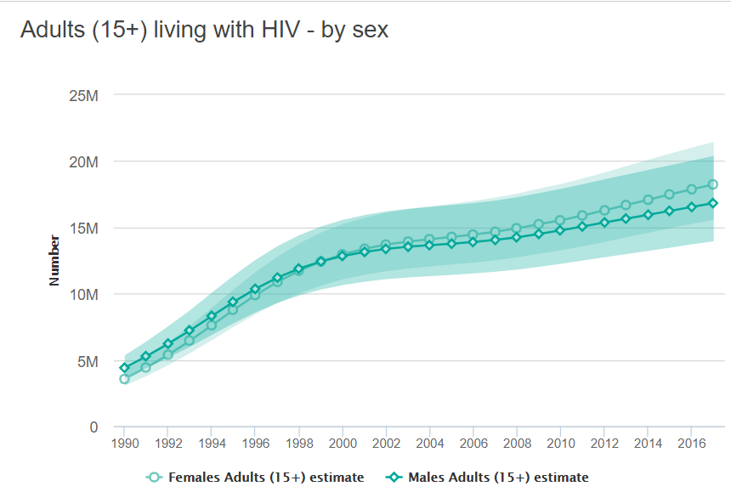
52% adults living with HIV are women
18.2 million
UNAIDS 2018
Notes:
52% of adults living with HIV are women. That’s 18.2 million women by current estimates

Slide 6
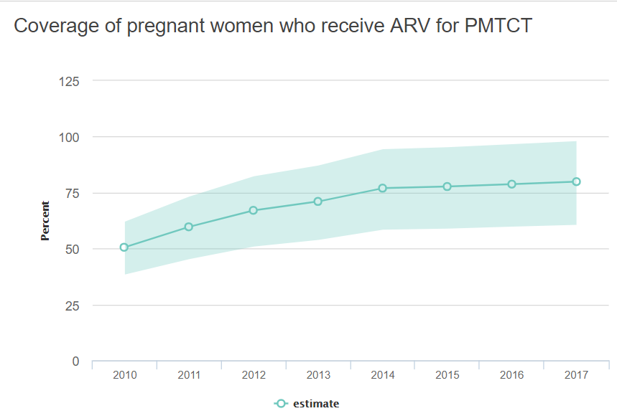
~10% time pregnant or breastfeeding
1.1
million
80%
UNAIDS 2018
Notes:
About 10% of her adult life is spent pregnant or breastfeeding, so 1.1 million pregnant women were in need of ART last year. The figure shows a gradual increase each year in the coverage rate and 80% of pregnant women now receive lifelong ART [KEY]

Slide 7
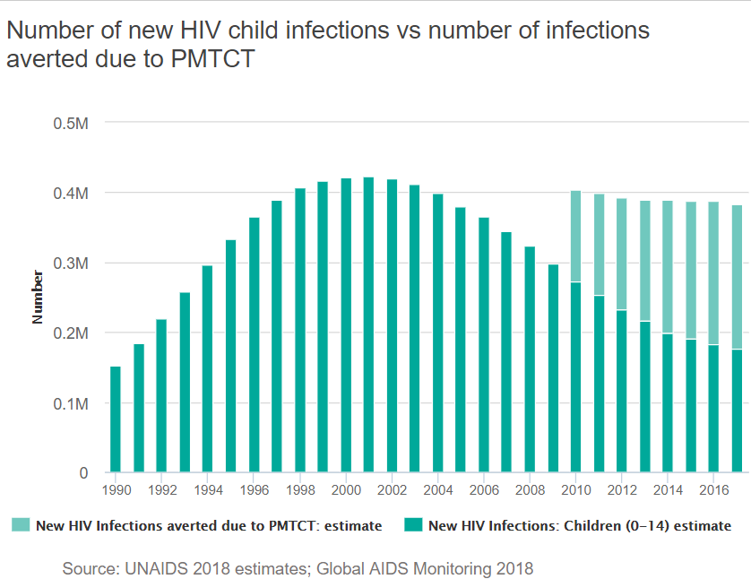
Lifelong ART benefits both mother and child
Reduces peri- and post-partum transmission of HIV
  Eliminate paediatric HIV by 2020
210 000 averted infections
180 000 new infections
UNAIDS, Global AIDS Monitoring 2018
Notes:
…which benefits both mother and child. It reduces peri- and post-partum transmission of HIV such that we’re on the path to eliminate paediatric HIV by 2020 – at least in some countries. As you can see from the graph, the number of new HIV child infections peaked in the late ‘90s and early 2000’s and has begun to fall while the number of infections averted is increasing each year [KEY]

Slide 8

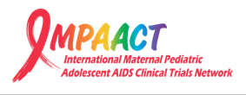
Lifelong ART benefits both mother and child
Safeguards maternal health
  Halving rate of WHO 2/3 conditions among young healthy women with high CD4 counts
  Toxicity rates low
  Virological failure rates high (23%)
www.impaactnetwork.org/publications/
Currier – 1077HS PROMISE Team, PLOS One 2017
Notes:
Lifelong ART also safeguards maternal health, data from the PROMISE study revealing that it halves the rate of WHO 2 and 3 conditions among young healthy women with high CD4 counts compared to women taking ART as treatment for prevention –what used to be called Option B. Toxicity rates were low but virological failure rates were high at 23% [KEY]

Slide 9
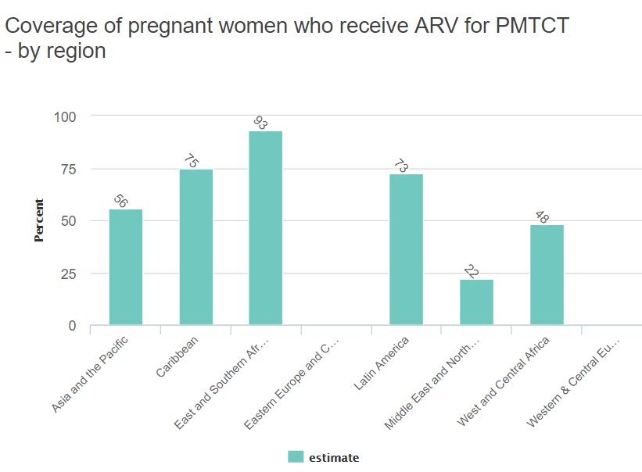
Lifelong ART benefits both mother and child
Access is highly variable across and within regions
95%
4/23 Focus Countries reached 95% target
80% of new paediatric infections came from rest
UNAIDS 2018
Notes:
However, access is highly variable across and within regions as you can see from the blue graph on your left for different regions of the world [KEY] and this red graph on your right of the 23 focus countries – mostly in sub-Saharan Africa – where 4 reached the target of 95% of pregnant women receiving ART. 80% of new paediatric infections were recorded from the other countries that hadn’t reached this target [KEY]

Slide 10
Retention and adherence challenging
Maternal postpartum retention in B-plus era
Factors associated with disengagement from care
Younger age
Same-day ART initiation
Initiation late in pregnancy
Post-partum period
Fear of disclosure, stigma, social discrimination (emotional stresses)
Logistical barriers to care – finances, transportation, time commitment
76% of postpartum WLHIV retained in care at 12 months
Malawi [Haas, CID 2016] :
30% of WLHIV in care had adequate adherence to 2 years post ART initiation in pregnancy
South Africa [Myer, CID 2017] :
70% of WLHIV in care had sustained viral suppression to 12 months postpartum
Knettel, JAIDS 2018 courtesy of Amy Slogrove
Notes:
Retention in care and adherence remain challenging, even where women are receiving lifelong ART. A recent meta-analysis estimated in the B-plus era pooled retention at 12 months post-partum to be 76%. [KEY] In Malawi, amongst postpartum women retained in care only 30% demonstrated adequate adherence during the first 2 years. And in Cape Town, sustained viral suppression to 12 months post-partum only occurred in 70% of women even though they were in care [KEY]. Common factors associated with disengagement from care have emerged across studies. In qualitative research, themes that consistently emerge relate to fear of disclosure, social discrimination and logistical barriers to care including finances, transportation, time commitment. Practitioners and policy makers have a lot more work to do to meet the needs of women on ART at this time in their lives.

Slide 11
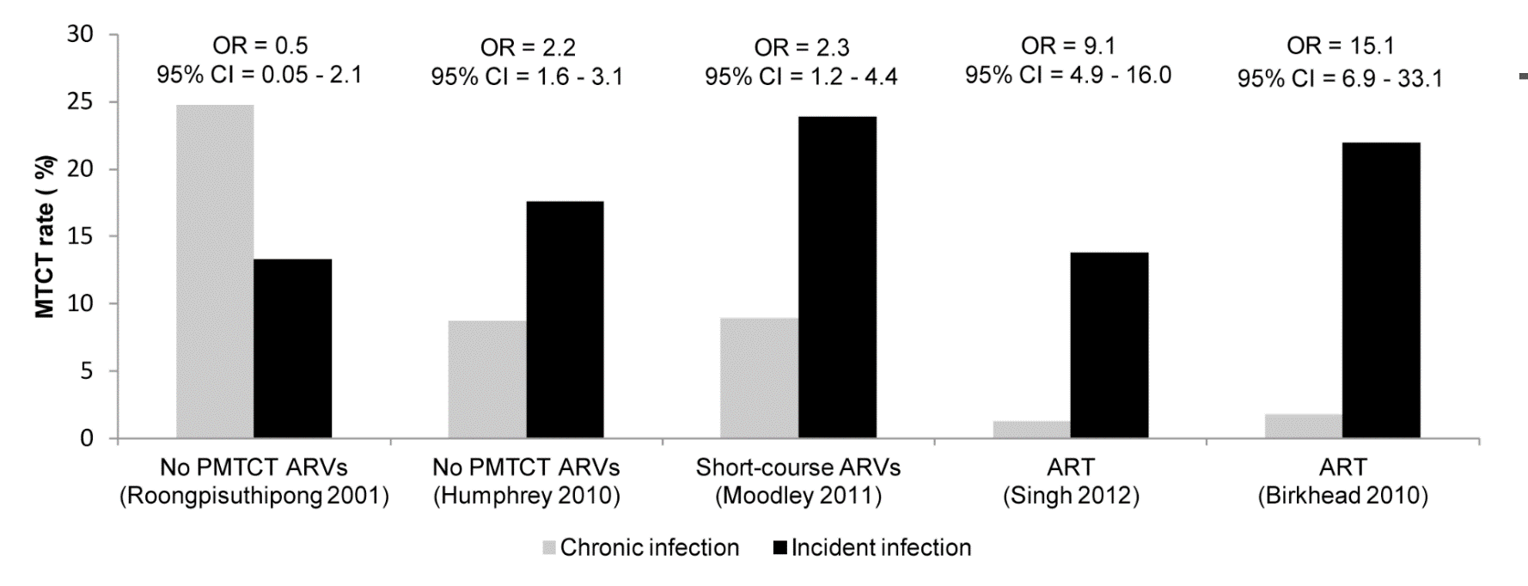
Incident infection in pre- and post-partum periods
High risk of incident infection overall
High risk of transmission to infant
Thomson et al, CROI 2018. Drake AL,PLoS Med 2014.
Notes:
The peri- and post-partum period also has a high risk of incident HIV infection overall [KEY] with a rate of 2.97 new infections per 100 person years in late pregnancy and a staggering 4.18 per 100 person years in the post-partum period [KEY]. Incident infection increases the risk of transmission to the infant [KEY] some series showing a 9 or 15-fold increased risk. Illustrating why HIV treatment and prevention for pregnant women should be a priority across the globe [KEY]

Slide 12
Optimal universal ART regimen
Rapid and sustained viral suppression
Well tolerated
High threshold for viral resistance
Favourable drug-drug interactions (TB, malaria, hormonal contraceptives)
Affordable price
Safe for mother & baby
Pregnant Woman by Cuth
Notes:
The optimal universal ART regimen should achieve rapid and sustained viral suppression to improve maternal health and prevent transmission to the infant [KEY], be well tolerated which can be tricky in women who often feel nauseous [KEY], have a high threshold for viral resistance [KEY], favourable drug-drug interactions as women will need treatment for conditions like TB or malaria and could choose to take hormonal contraceptives [KEY]. The ideal regimen needs to be affordable for governments and the community [KEY] and, be safe for both mother and baby. And here [KEY] is where I reflect back on the day when I first met Shamiso – about 20 years ago.

Slide 13
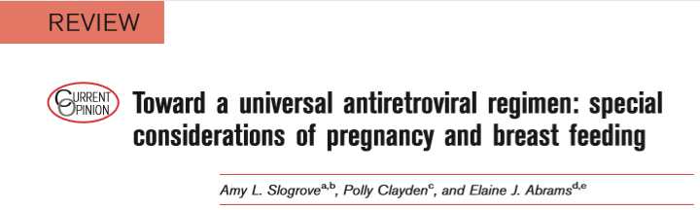
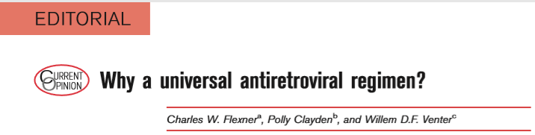
“Selection of an appropriate ART regimen in pregnancy requires consideration of regimen efficacy for maternal health and prevention of vertical HIV transmission, pregnancy pharmacokinetic (PK) changes as well as maternal and fetal safety. Considering that ARVs have been prescribed for pregnant women for more than two decades, the paucity of data relating to the efficacy and safety for pregnant women and their ARV-exposed children is striking.” Slogrove, A Curr Opin HIV AIDS 2017
Current efforts are suboptimal
Notes:
Our current efforts are suboptimal. And I read from a 2017 publication : Selection of an appropriate ART regimen in pregnancy requires consideration of regimen efficacy for maternal health and prevention of vertical HIV transmission, pregnancy pharmacokinetic (PK) changes as well as maternal and fetal safety. Considering that ARVs have been prescribed for pregnant women for more than two decades, the paucity of data relating to the efficacy and safety for pregnant women and their ARV-exposed children is striking

Slide 14
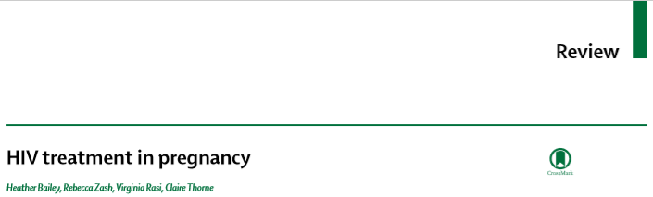

“The biological mechanisms that underlie observed associations between antenatal ART and adverse outcomes in pregnancy and birth are not completely understood, with further research needed as well as strengthening of the systems to assess safety of antiretroviral drugs for the mother and HIV-exposed child. In the treat-all era, as duration of treatment and options for ART expand, pregnant women will remain a priority population for treatment optimisation to promote their health and that of their ART-exposed children.” Bailey, H Lancet HIV 2018
Current efforts are suboptimal
Notes:
And an insightful review published last month : The biological mechanisms that underlie observed associations between antenatal ART and adverse outcomes in pregnancy and birth are not completely understood, with further research needed as well as strengthening of the systems to assess safety of antiretroviral drugs for the mother and HIV-exposed child. In the treat-all era, as duration of treatment and options for ART expand, pregnant women will remain a priority population for treatment optimisation to promote their health and that of their ART-exposed children.” [KEY]

Slide 15
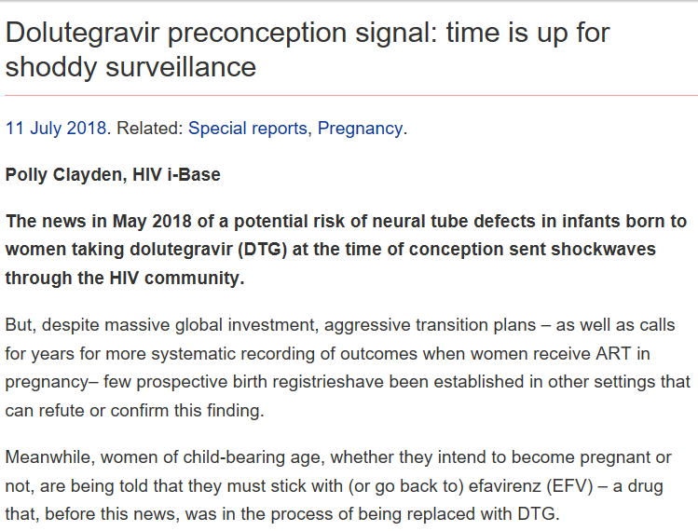
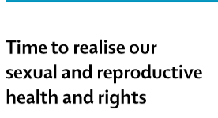
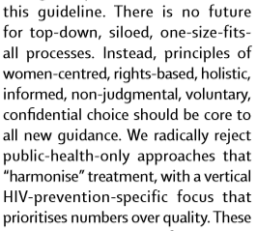

Recent call to action
http://i-base.info/htb/34459
Notes:
There has been a repeated call to action, even here at this conference, to improve the current system which is failing women. Because, in this regard, not much has changed since the days of Shamiso [KEY]

Slide 16
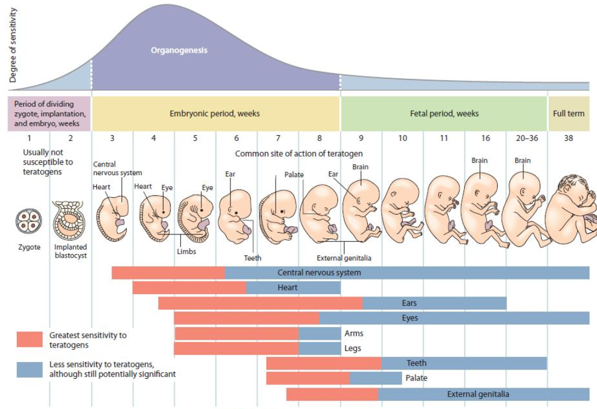
Toxicity important in early pregnancy
- often before realising she’s pregnant
Weeks 3-8:
most sensitive to teratogens
Lynne Mofenson, 2018
Notes:
We know that toxicity of a drug is important in early pregnancy – for any drug, ARVs included. And it is always a trade-off between the benefits of treating a serious condition in the mother and the risk of harm to the fetus. I’d like to draw your attention to this graphic which shows the stages of development of the organs inside a baby’s body after the time of fertilisation. The red box outlines the period of organogenesis which is between weeks 3 and 8, the time when the fetus is most sensitive to teratogens that can affect the way a body organ develops – and often before the time a woman realises she’s pregnant. Okay, confession time – it took me 16 weeks to realise with my first pregnancy. Okay. Clueless, I know. Moving on [KEY]

Slide 17
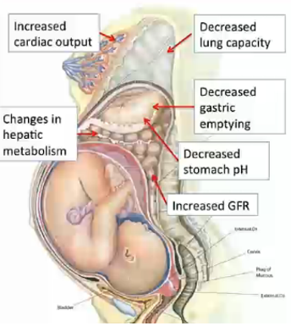
Physiological changes in later pregnancy could affect ARV drug levels
Absorption
↓ GI motility
delayed GI emptying
↓ gastric acid secretion
altered transporters
IMPAACT P1026s
Distribution
↑ total body fluid
↑ blood/plasma volume
↑ body fat (3-10kg)
altered protein binding
altered transporters
Metabolism and Elimination
↑ hepatic and renal blood flow
↑ ↓ CYP450 activity
altered transporters
Example
TFV levels 20-33%↓ during pregnancy
Anderson, Clin Pharmakokinetics 2005
Notes:
There are physiological changes in later pregnancy that could affect ARV levels, potentially impacting safety and efficacy of ART [KEY]. Changes in absorption [KEY] distribution [KEY] metabolism and elimination producing as an example [KEY] a 20-33% reduction in drug levels during pregnancy [KEY]. The IMPAACT P1026s team having developed particular expertise in this area and pharmacokinetic studies of ARVs in infants [KEY]

Slide 18
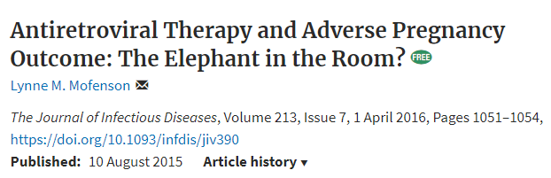
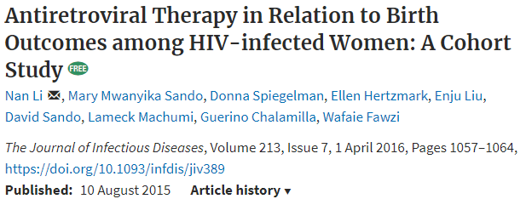
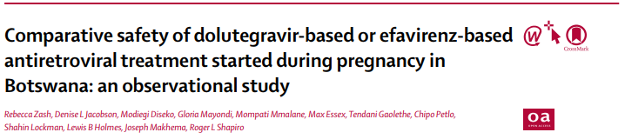

ARVs may increase risk of adverse pregnancy outcome
Preterm delivery
Fetal loss/stillbirth
Low birth weight
Neonatal death
Infant anaemia
Lactic acidosis
Notes:
ARVs may increase the risk of adverse pregnancy outcome, including preterm delivery, fetal loss and stillbirth, low birthweight, neonatal death, infant anaemis and lactic acidosis [KEY]

Slide 19


“…..although ART has great benefits, including prevention of perinatal transmission and saving mothers’ lives, surveillance systems to enable early detection of signals of potential adverse effects are needed to assess safety of new drugs in pregnancy and women of childbearing age.”
Pregnant Woman by Cuth
Notes:
As we sit here today to hear about the State of ART, about new drugs in development, let’s reflect on Shamiso’s story [KEY] although ART has great benefits, including prevention of perinatal transmission and saving mothers’ lives, surveillance systems to enable early detection of signals of potential adverse effects are needed to assess safety of new drugs in pregnancy and women of childbearing age. [KEY]

Slide 20
Acknowledgements
Conference organisers
IMPAACT
Community Advisory Board
Sharon Nachman
James McIntyre
Elaine Abrams
Mark Mirochnick
PROMISE Study Team
IMPAACT 2009 Study Team
IMPAACT 2010 Study Team
Community of women living with HIV
Thank you for the inspiration Lynne Mofenson
Polly Claydon
Amy Slogrove
Notes:
Thank you.

